Slide 1
Head Localization
Sophie Kaltenleithner, Simone Sandler

Slide 2
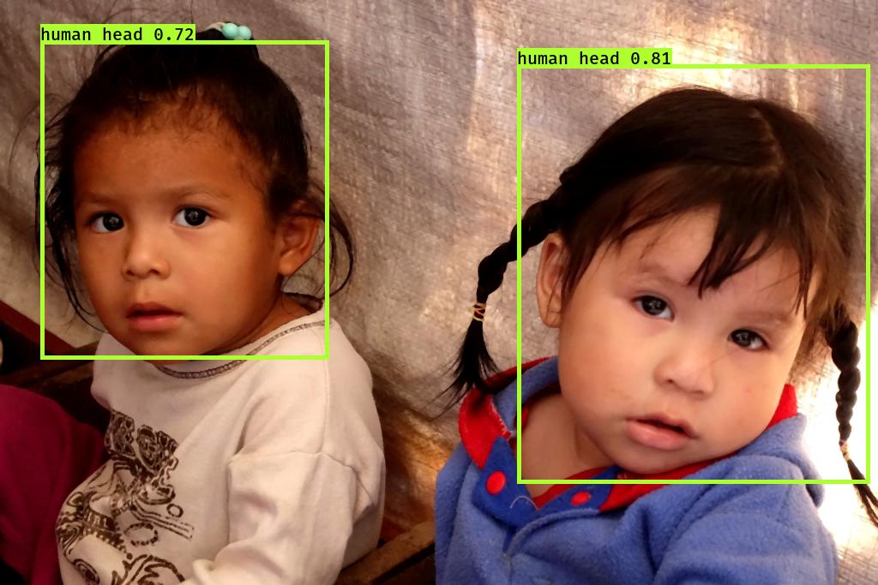
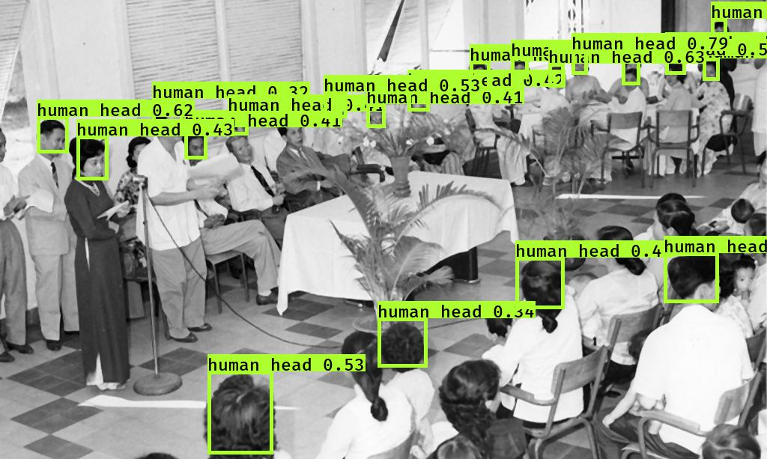
Goal: Localize Human Heads

Slide 3
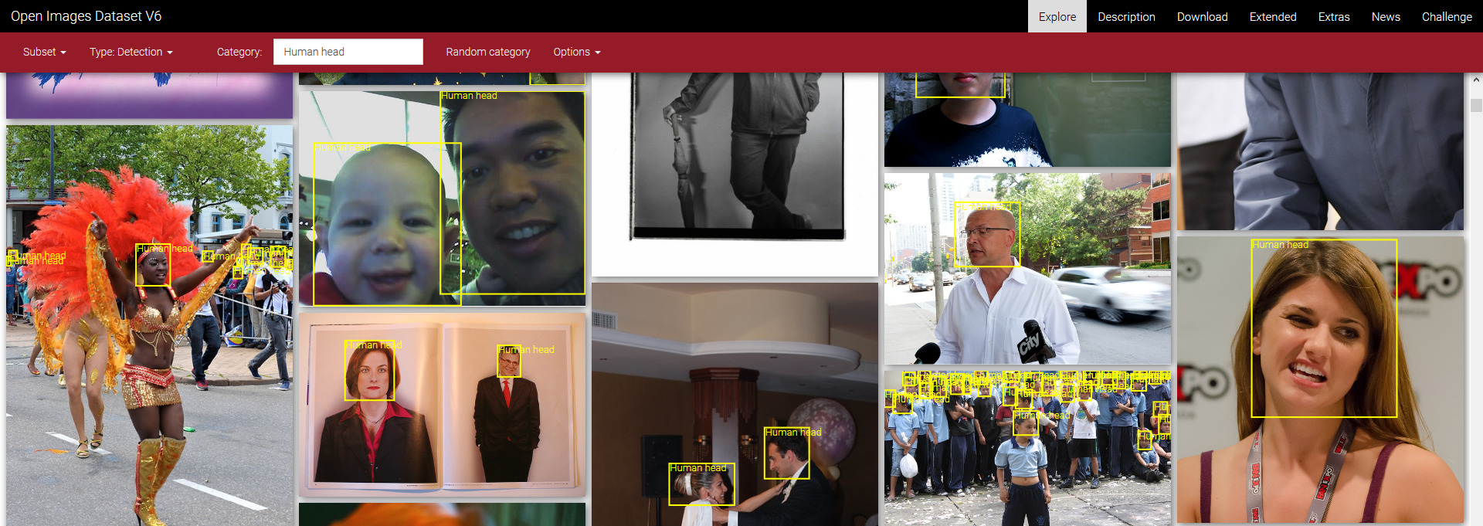
Dataset
Open Images v6
Provides bounding boxes for 600 categories
Human head was used as ground truth

Slide 4

Method
YOLO v3 network
Combines:
Bounding boxes
Classification
Confidences
Pretrained weights from darknet
Transfer learning
Stage 1: Freeze pretrained weights
Stage 2: Unfreeze pretrained weights

Slide 5
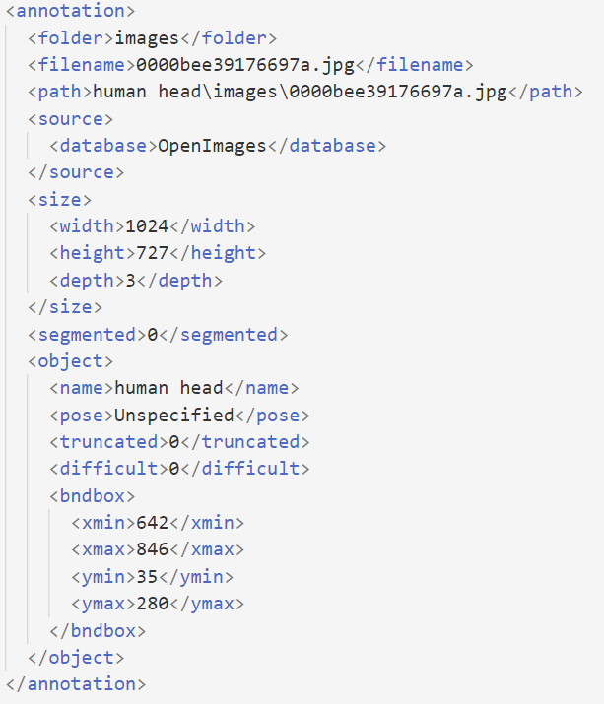
Preprocessing
Transform data annotations (Pascal VOC XML → YOLO Darknet TXT)
Split into train/validation and test:
4500 train/validation
500 test
Median filter
Histogram equalization

Slide 6
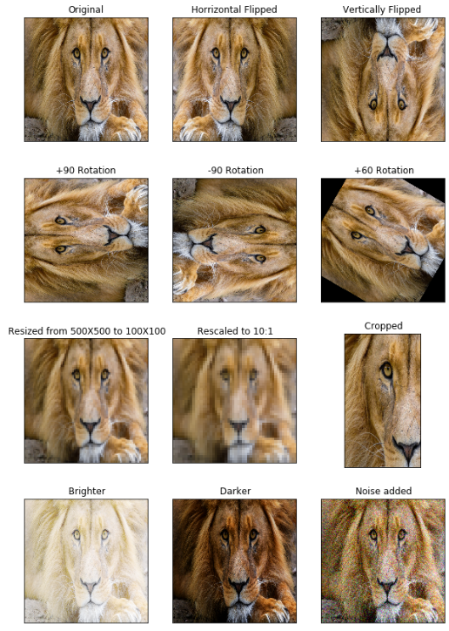
Data Augmentation
We used:
Zoom
Translation
Flipping (left-right)
Conversion to gray-scale
Image distortion by assigning a new random aspect ratio
Random color distortion by adjusting the HSV-values

Slide 7
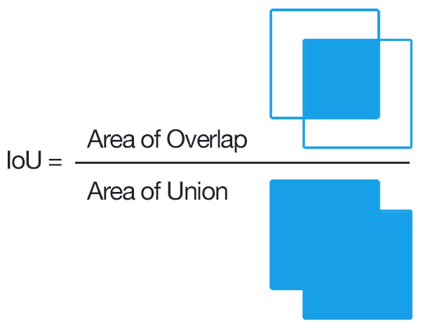
Quality Metrics
Mean intersection over union (IOU)
Non-Zero intersection ratio (nZIR)
Recall
TP / (TP + FN)

Slide 8
Runs
Different combinations of:
Data Augmentation (On/Off)
Median Filter (On/Off)
Histogram Equalization (On/Off)
Number of epochs

Slide 9
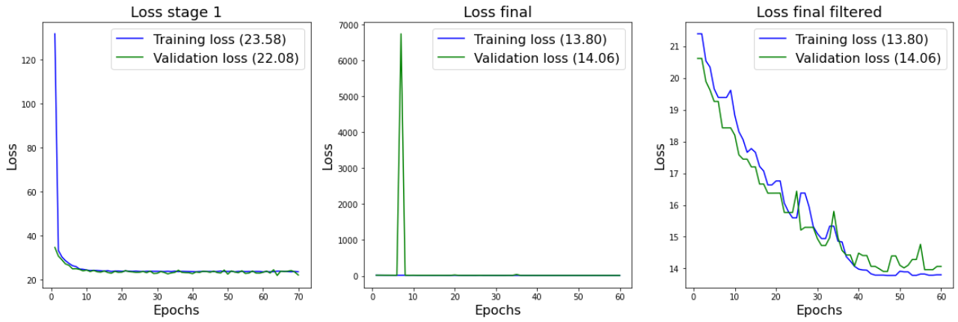
With Data Augmentation
Epoch | Augmentation | Median Filter | Histogram Equalization | IOU | Recall | nZIR
70*2 | Yes | No | No | 0.57 | 0.73 | 0.76

Slide 10
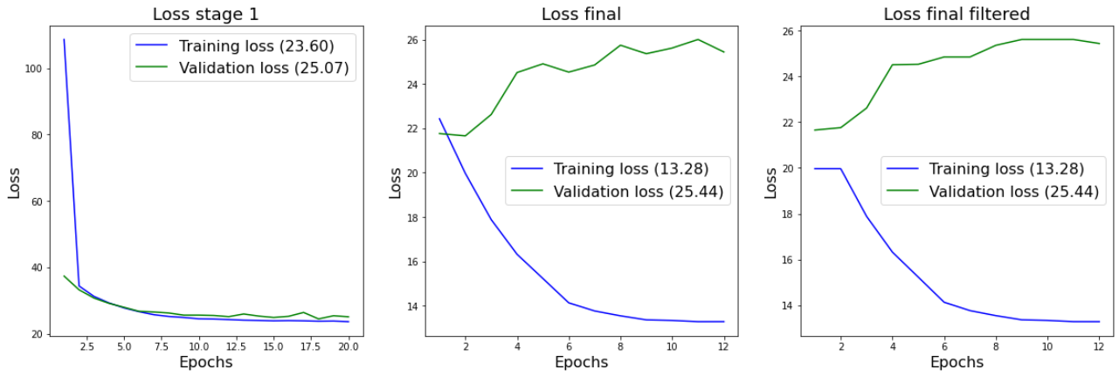
No Data Augmentation → Worst Run
Epoch | Augmentation | Median Filter | Histogram Equalization | IOU | Recall | nZIR
20*2 | No | No | No | 0.44 | 0.57 | 0.61

Slide 11
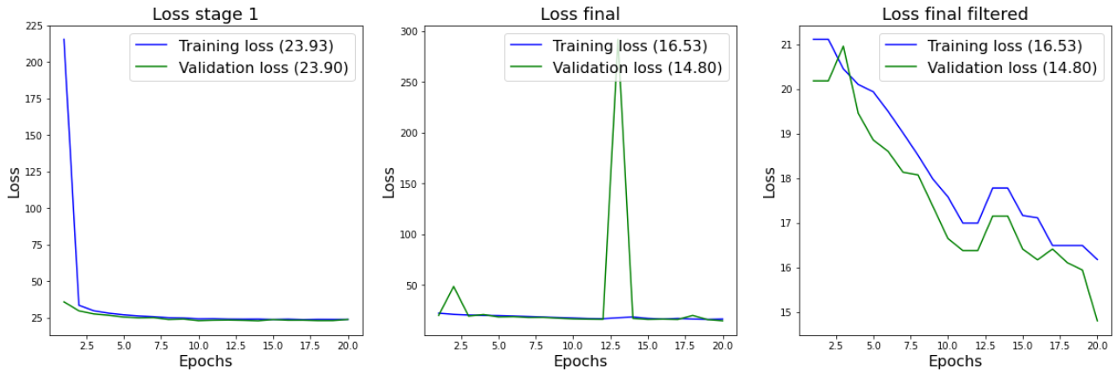
Median Filter → Best Run
Epoch | Augmentation | Median Filter | Histogram Equalization | IOU | Recall | nZIR
20*2 | Yes | Yes | No | 0.57 | 0.74 | 0.79

Slide 12
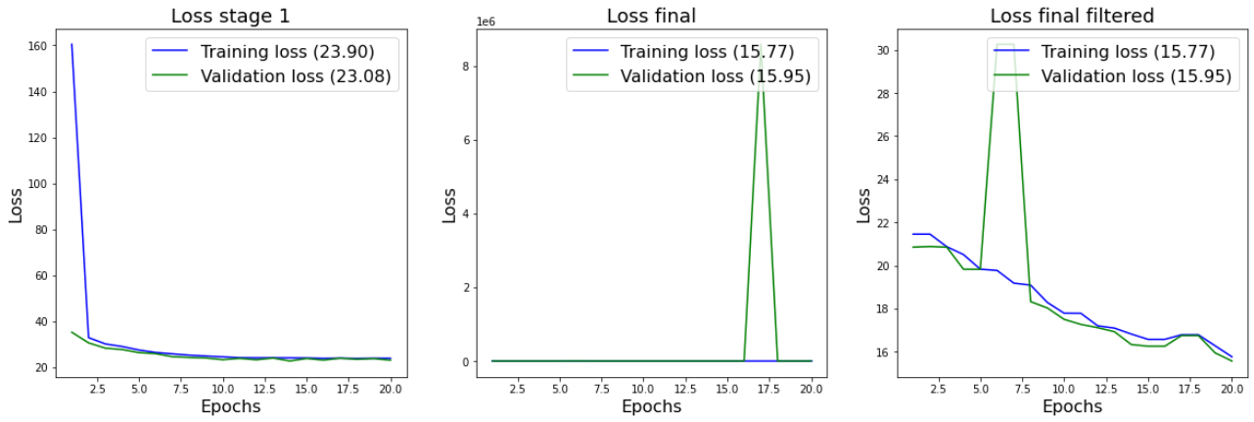
With Histogram Equalization
Epoch | Augmentation | Median Filter | Histogram Equalization | IOU | Recall | nZIR
20*2 | Yes | No | Yes | 0.50 | 0.64 | 0.70

Slide 13
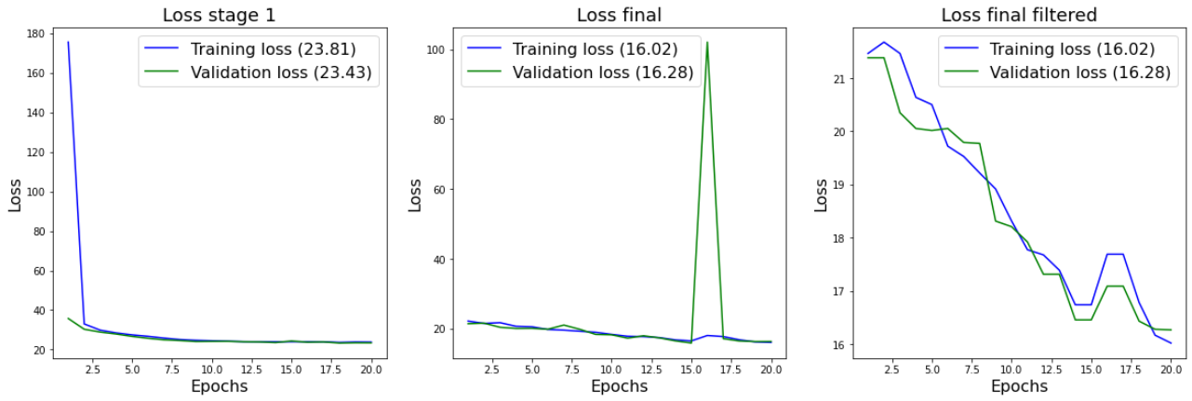
Median Filter + Histogram Equalisation
Epoch | Augmentation | Median Filter | Histogram Equalization | IOU | Recall | nZIR
20*2 | Yes | Yes | Yes | 0.52 | 0.67 | 0.72

Slide 14
Runs - Overview
Epoch | Augmentation | Median Filter | Histogram Equalization | IOU | Recall | nZIR
70*2 | Yes | No | No | 0.57 | 0.73 | 0.76
20*2 | No | No | No | 0.44 | 0.57 | 0.61
20*2 | Yes | Yes | No | 0.57 | 0.74 | 0.79
20*2 | Yes | No | Yes | 0.50 | 0.64 | 0.70
20*2 | Yes | Yes | Yes | 0.52 | 0.67 | 0.72

Slide 15
Results and Problems

Slide 16
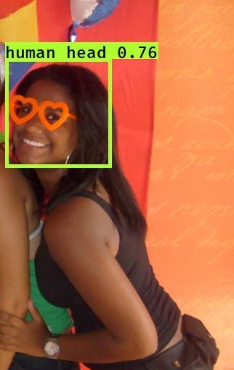
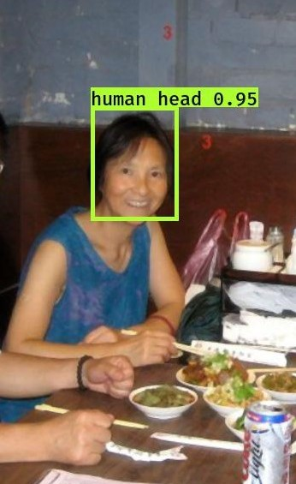
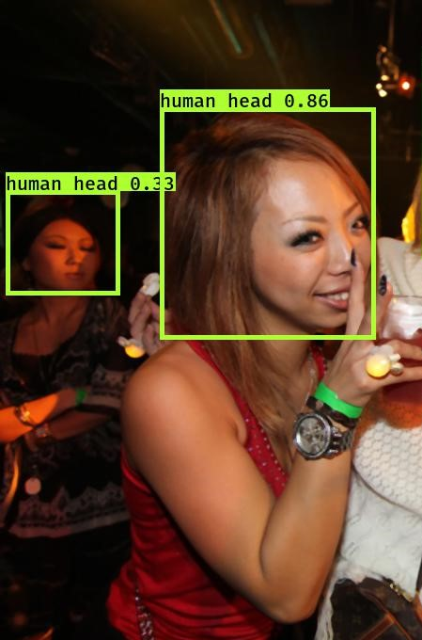
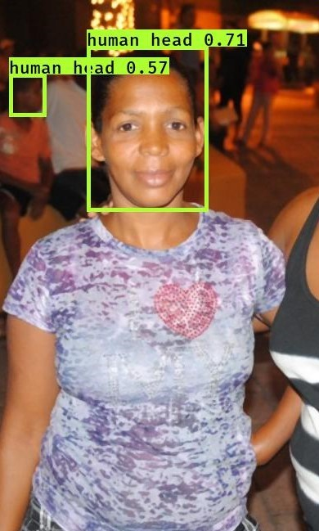

Slide 17
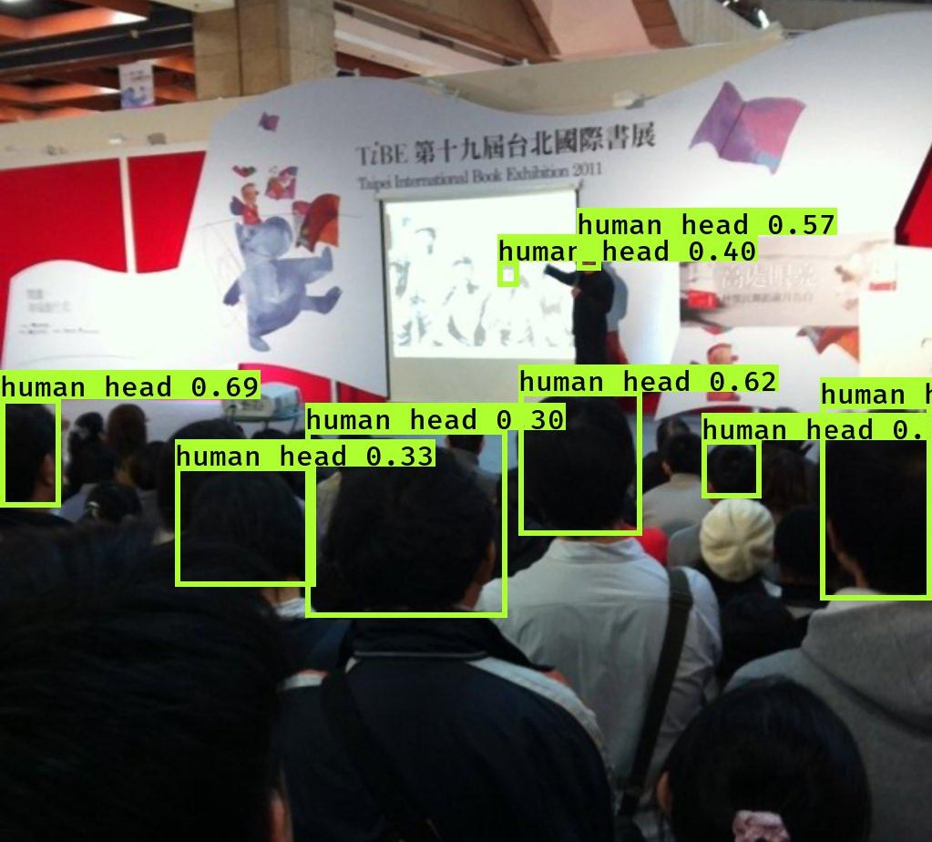
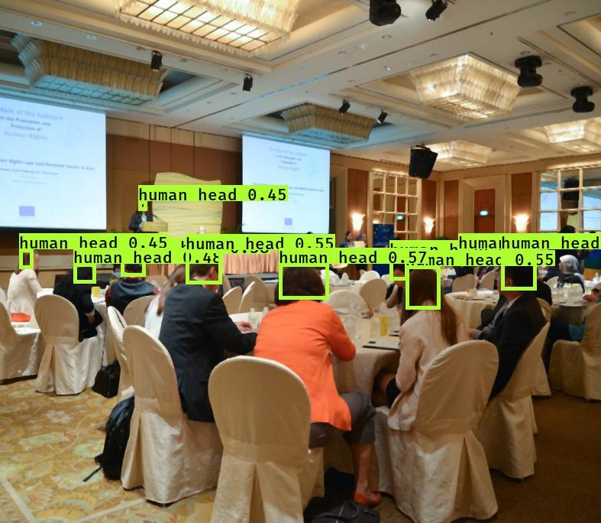

Slide 18
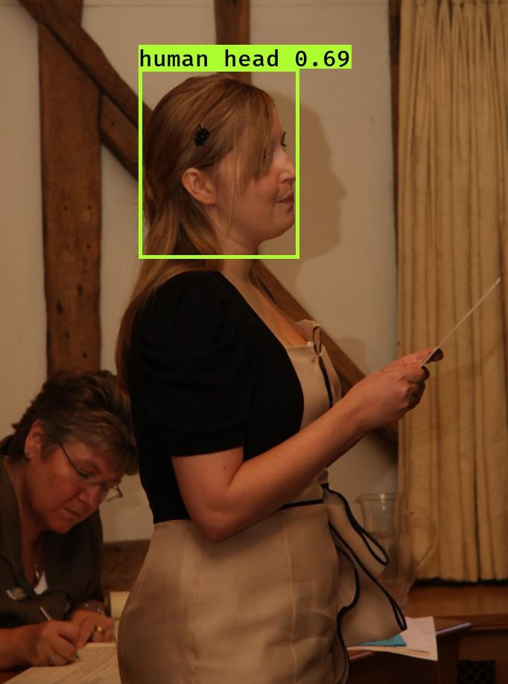
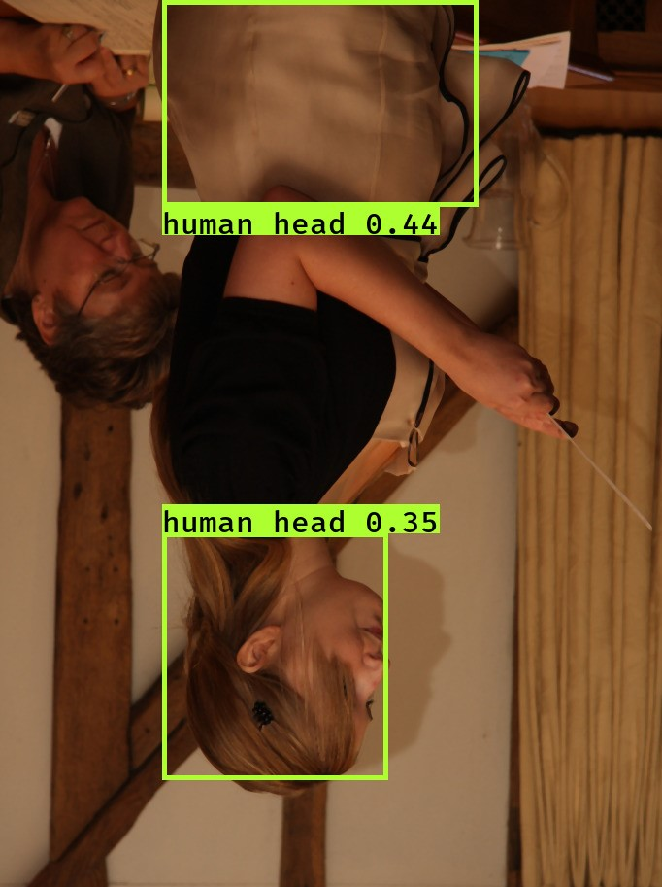

Slide 19
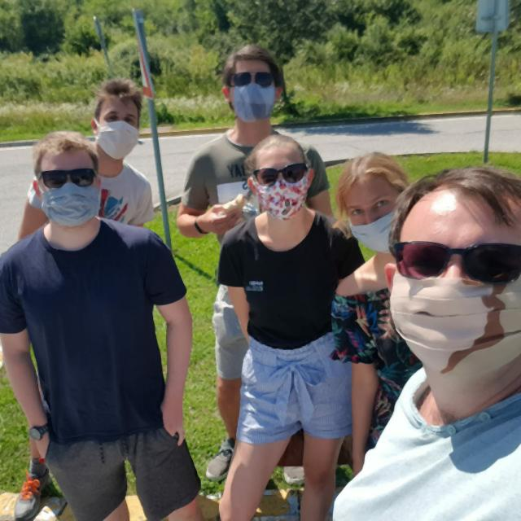
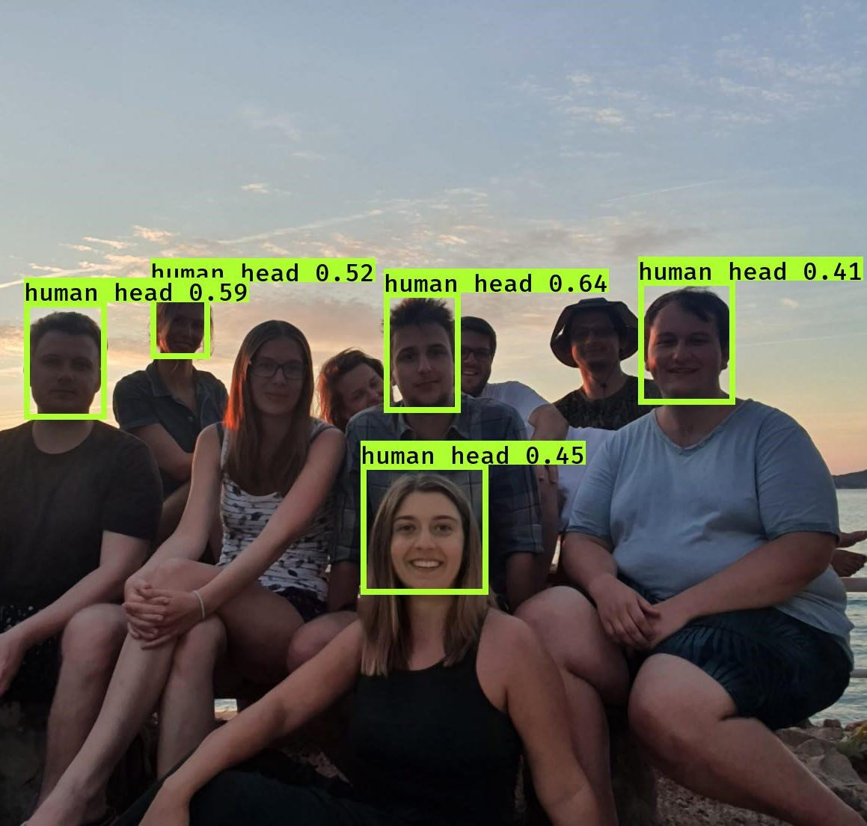

Slide 20
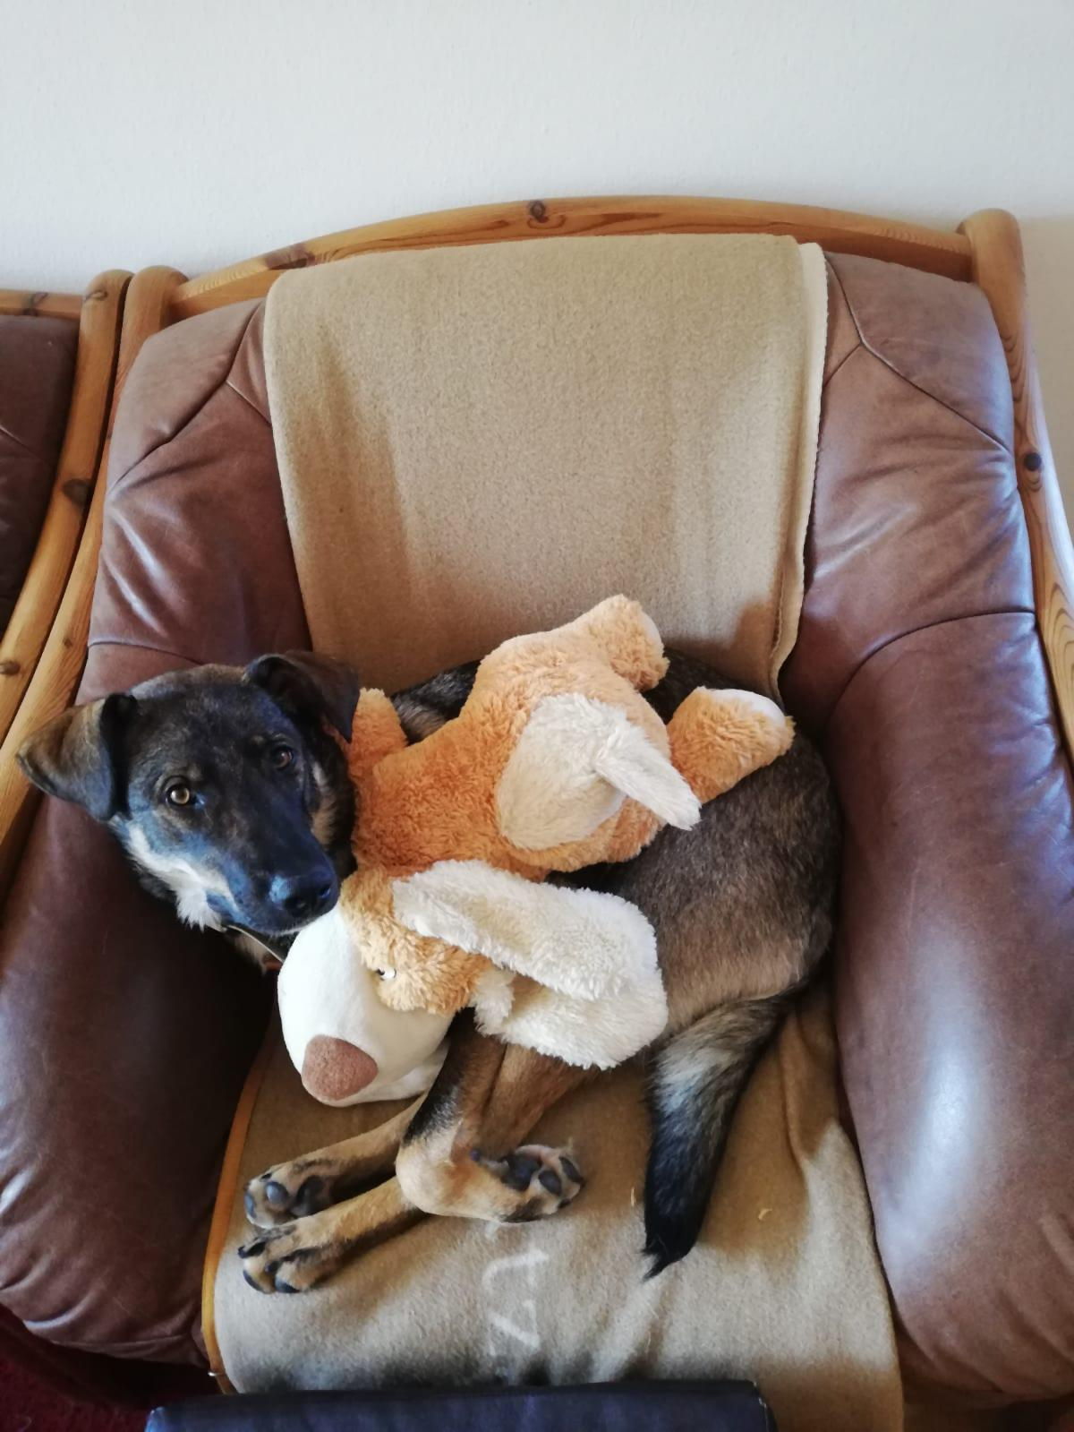
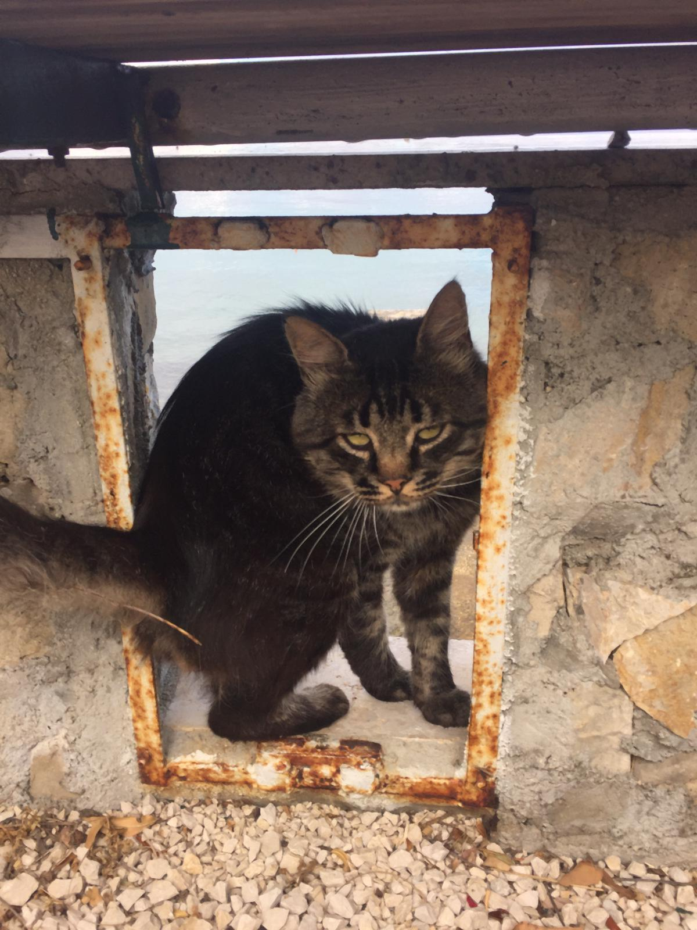
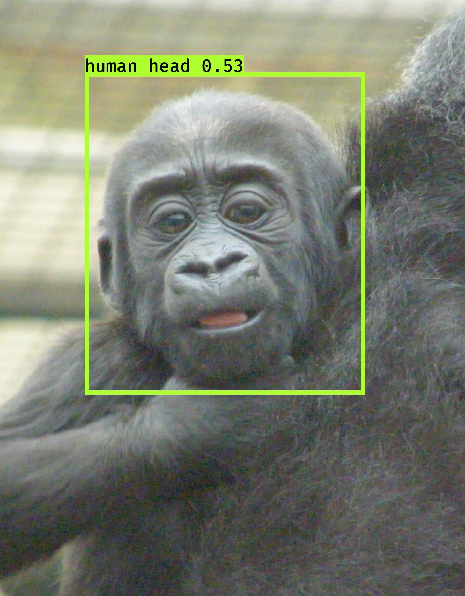

Slide 21

Questions?

